Slide 1
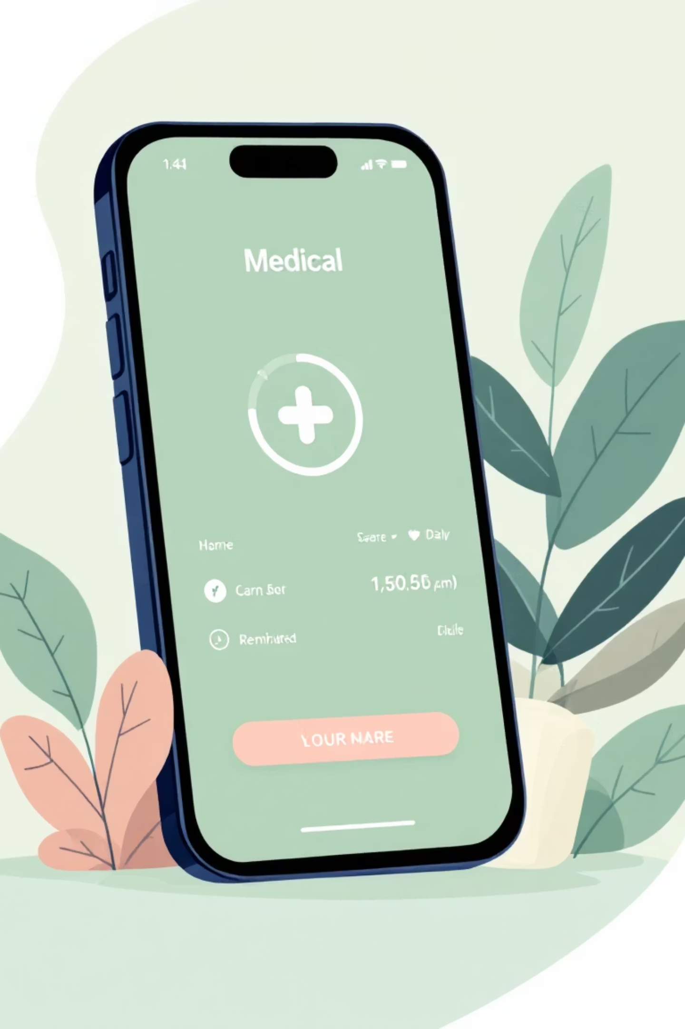

Smart Reminder – Your Health Partner
Medicine Medication App

Slide 2

The Critical Need for Medication Adherence
Proper medication management is paramount for health. Unfortunately, missed doses are a common problem with serious consequences, from reduced treatment efficacy to worsening health conditions.
Smart Reminder bridges this gap, offering a reliable solution to ensure you never miss a dose, fostering better health outcomes and peace of mind.

Slide 3
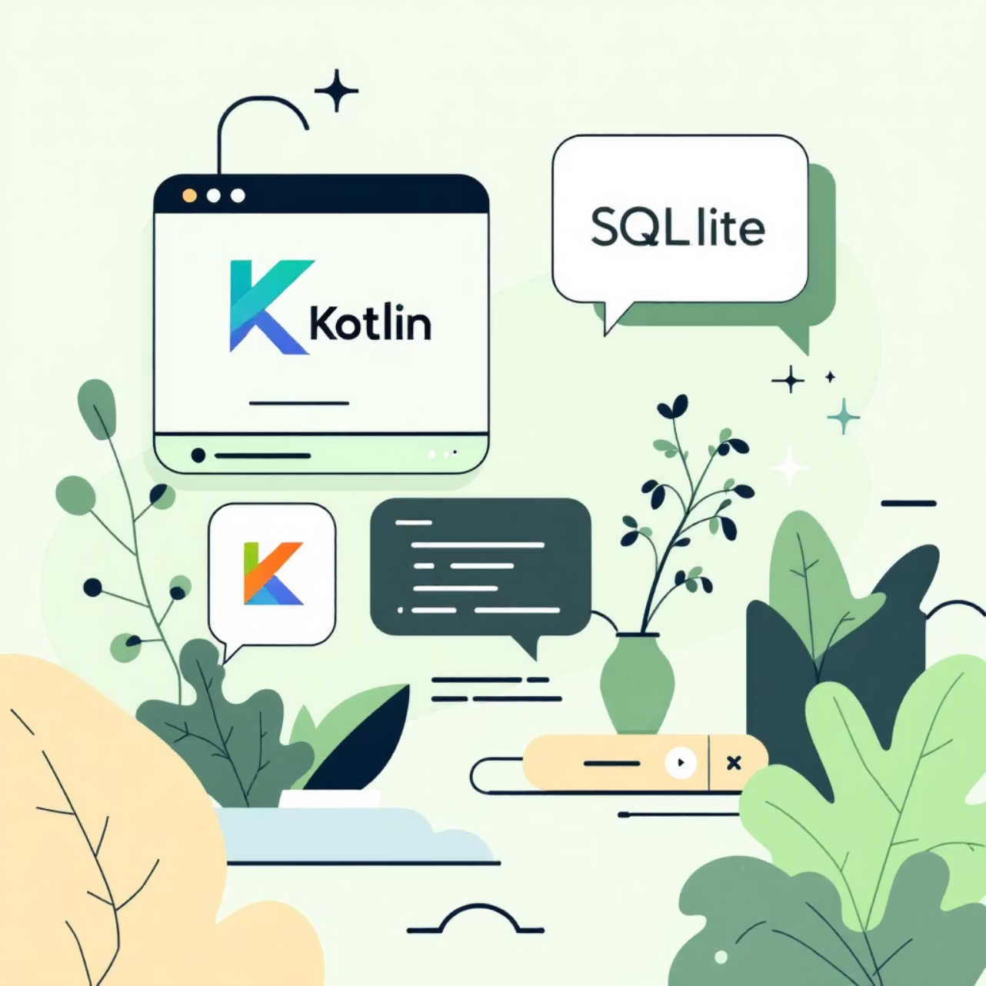
Smart Reminder: Designed for Your Well-being
Smart Reminder is a robust Android application meticulously crafted to enhance medication adherence. Built with cutting-edge technologies like Kotlin, SQLite, AlarmManager, and Android Jetpack, it prioritizes usability, reliability, and user health above all else.
Our focus is on delivering a seamless and intuitive experience, ensuring that managing your medication regimen is simple, effective, and stress-free.

Slide 4





Comprehensive Features for Complete Care
User Authentication
Medicine Management
Smart Reminder System
Secure access to your personal health data.
Effortless tracking and organization of all prescriptions.
Timely notifications, ensuring no missed doses.
History Logs
Emergency Call
Track adherence and review medication habits over time.
Quick access to assistance in critical moments.

Slide 5
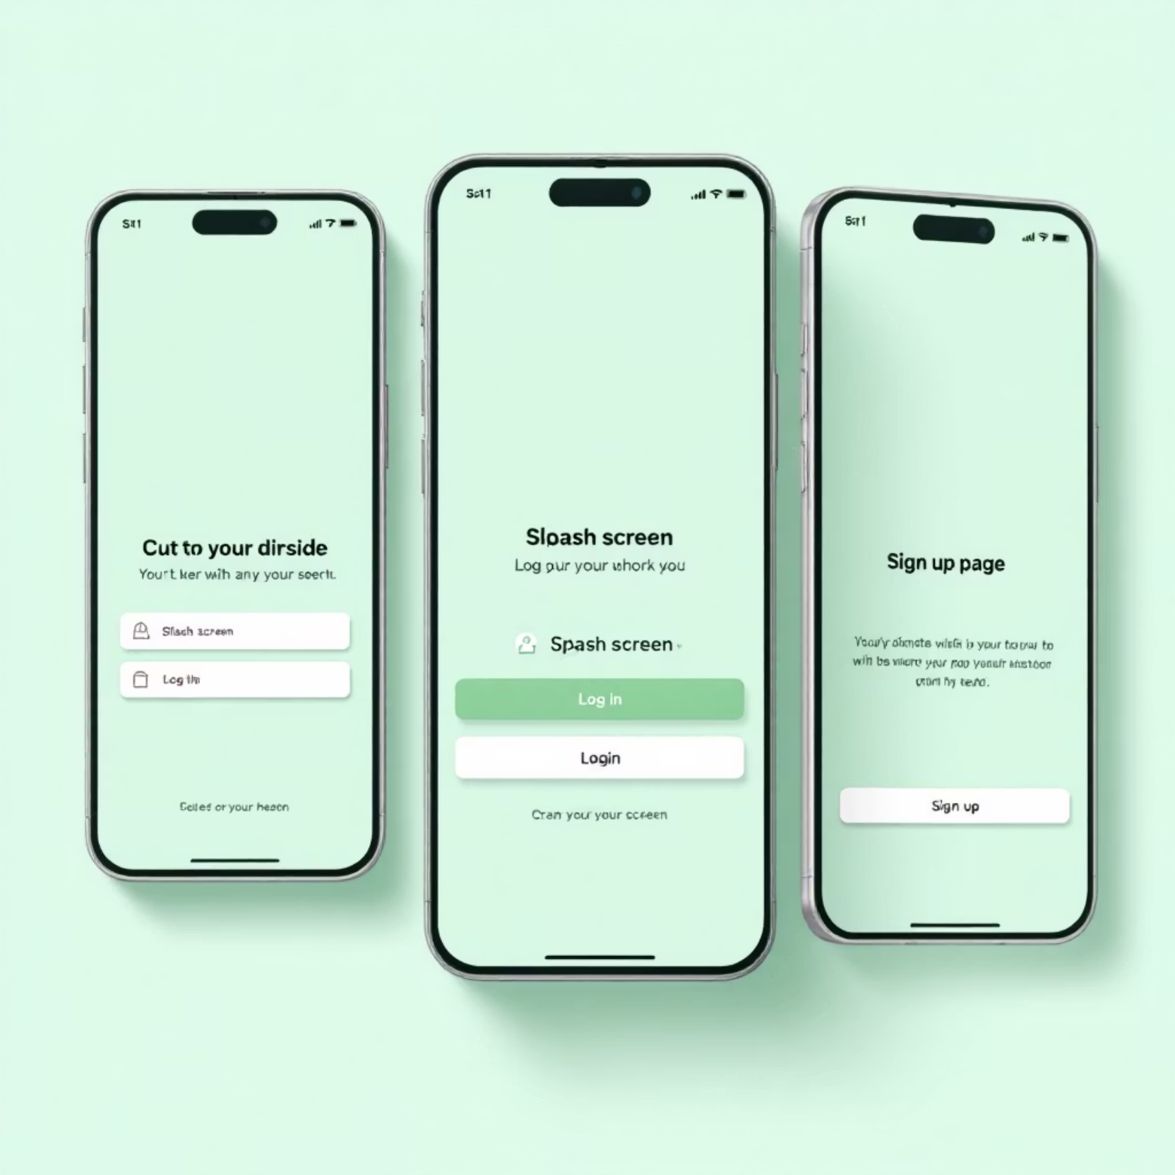
Seamless and Secure User Authentication
Your health data deserves the highest level of security. Smart Reminder offers a streamlined user authentication process, ensuring secure and personalized access.
Animated Splash Screen
Intuitive Login and Signup
Secure Data Validation
Smooth Navigation
Protecting your information while providing easy access is our top priority.

Slide 6
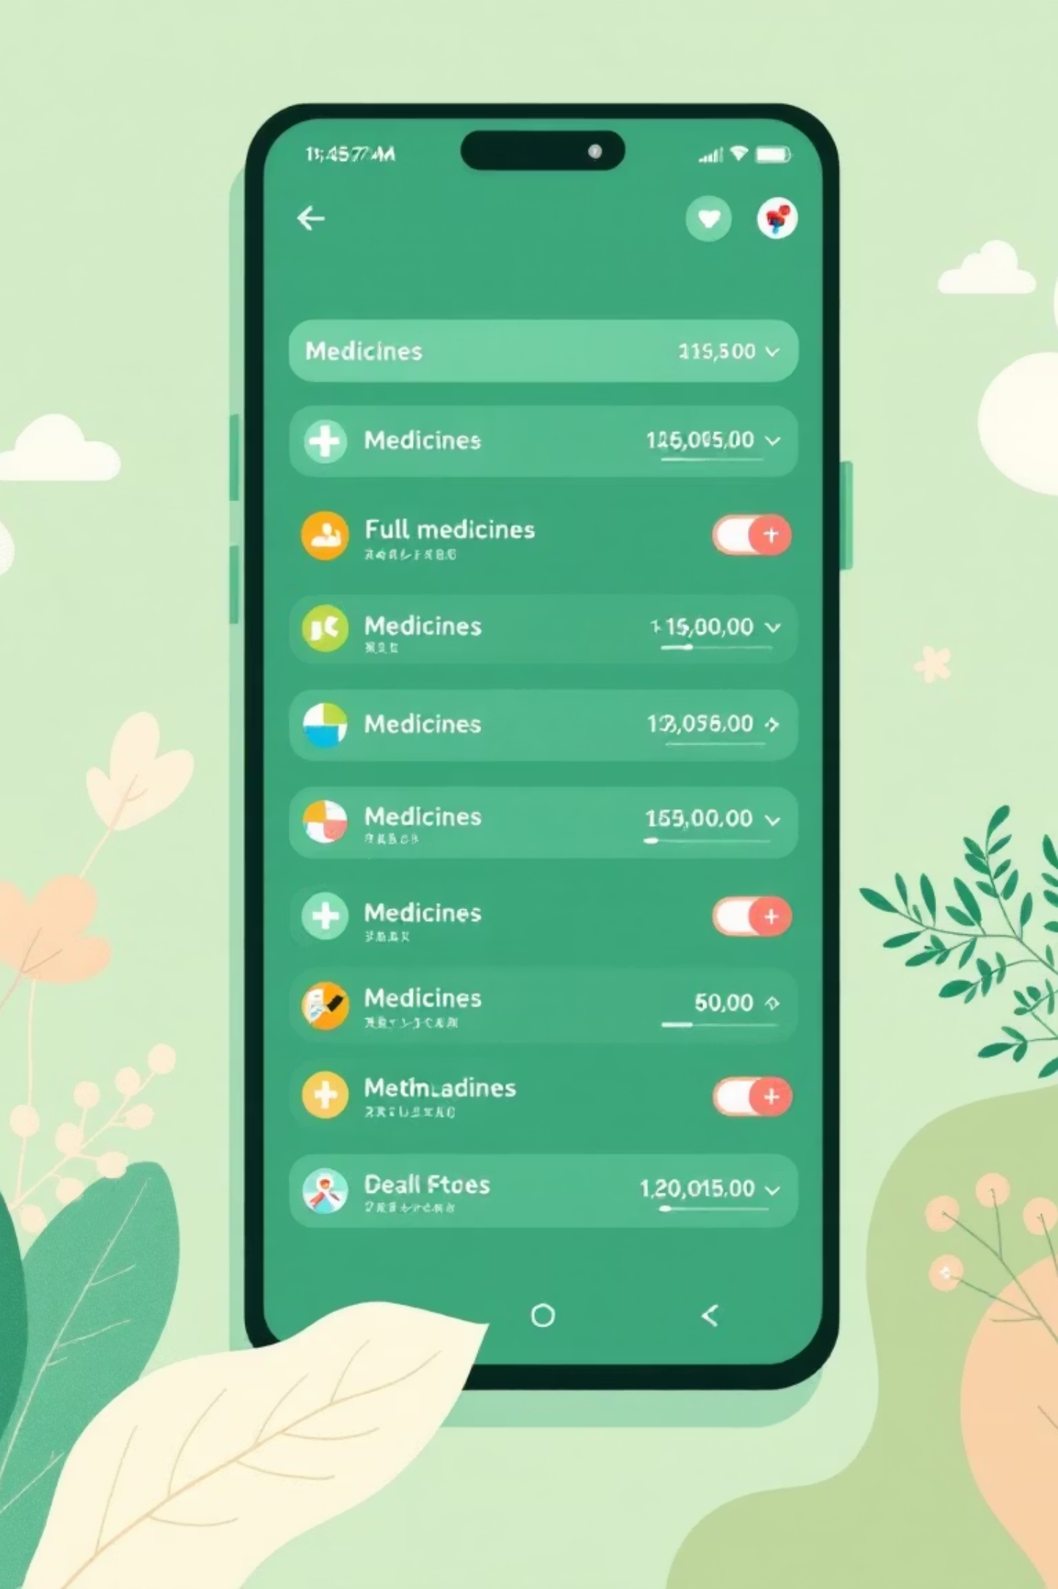




Effortless Medicine Management
Organize your prescriptions with unparalleled ease. Smart Reminder’s Medicine Management module puts you in control of your medication regimen.
Add Details
Input all relevant medication information quickly.
View Entries
Browse your complete medicine list via RecyclerView.
Edit & Delete
Maintain accuracy with simple modification options.
Progress Tracking
Visual indicators for taken vs. pending medicines.

Slide 7
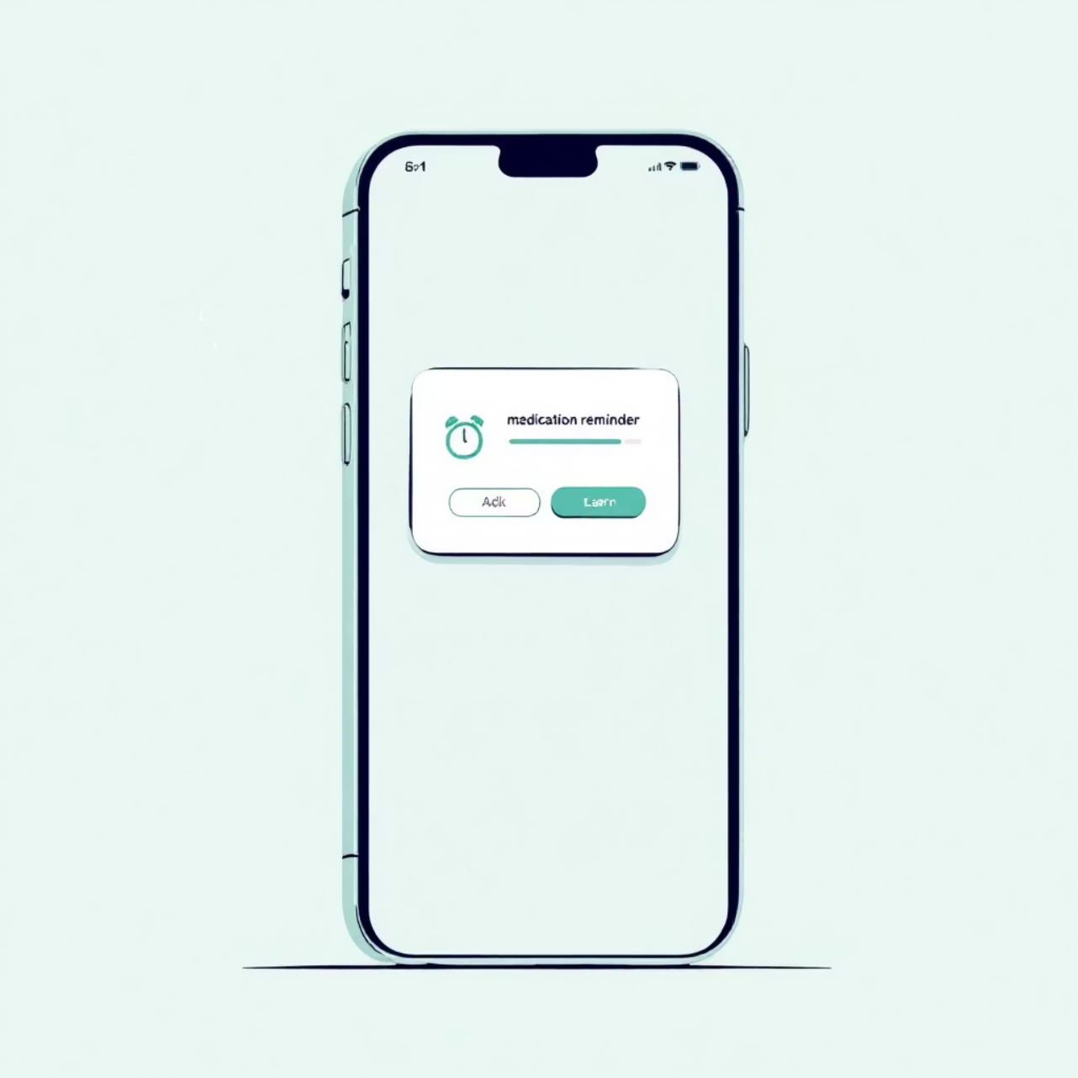
Intelligent Reminder System
Never miss a dose again with our advanced Smart Reminder System. Utilizing Android's AlarmManager, notifications are scheduled to ensure timely alerts, even if the app is closed or the device is restarted.
Persistent Reminders
Customizable Schedules
Reliable Offline Functionality
Ensures Consistent Adherence
This system guarantees peace of mind, knowing your health routine is always on track.

Slide 8

Review Your Health Journey with History Logs
Understanding your medication habits is key to better health. The History Logs feature provides a comprehensive overview of your adherence.
Screenshot 2025-11-20 at 3.33.02 PM
Monitor Missed Doses: Identify patterns and areas for improvement.
Review Habits Over Time: Gain insights into your consistency and progress.

Slide 9
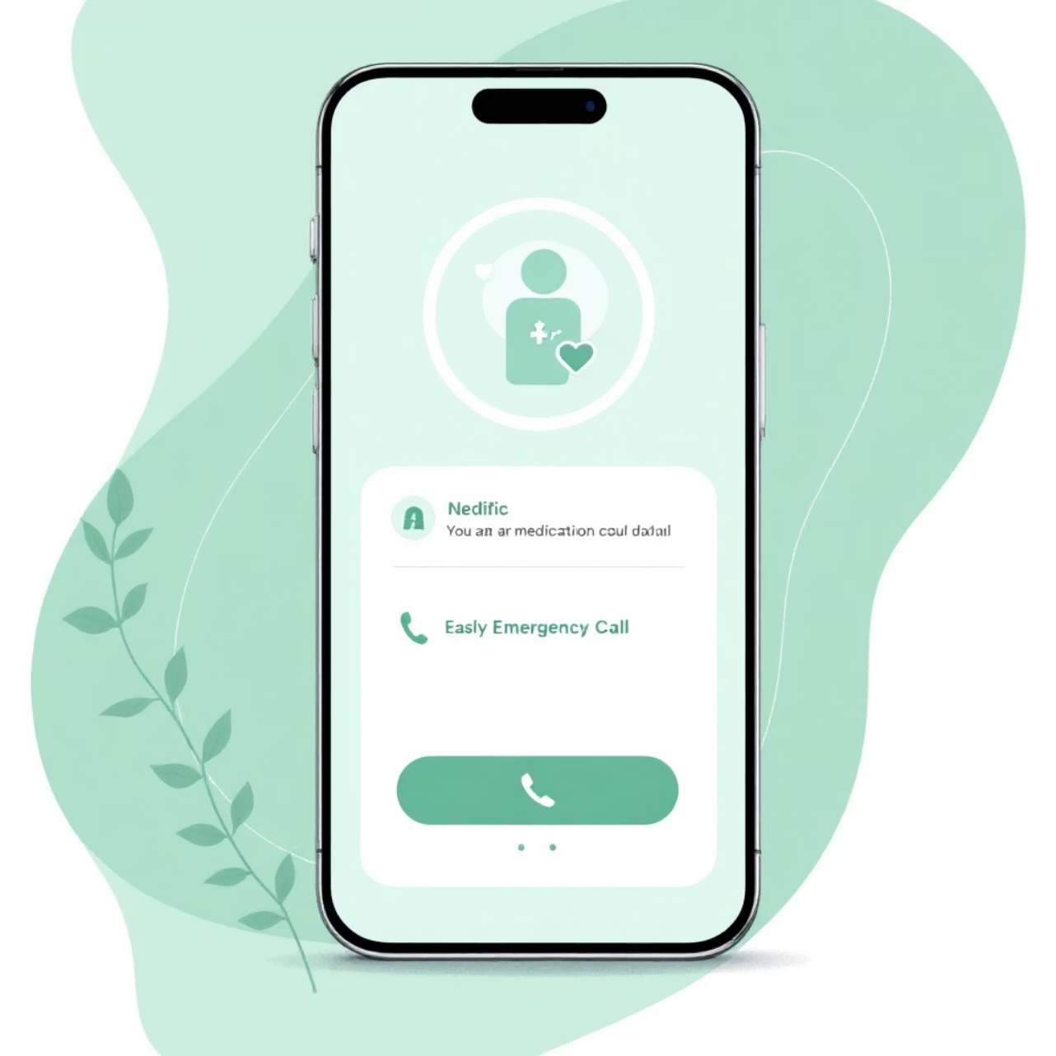
Emergency Assistance at Your Fingertips
In critical situations, every second counts. Smart Reminder's Emergency Call feature offers a crucial lifeline, providing immediate access to help.
One-Tap Emergency Action
Quick Dial to Pre-set Contacts
Peace of Mind for Users and Loved Ones
This feature underscores our commitment to not just medication management, but overall user safety and well-being.

Slide 10

Smart Reminder: Your Partner for a Healthier Future
Enhanced Health Outcomes
1
Consistent medication adherence leads to better treatment efficacy and overall well-being.
Unmatched Convenience
2
Intuitive design and reliable reminders simplify daily health routines.
Future Ready
3
Planned enhancements include cloud synchronization for data backup and wearable device integration.

Slide 11

Thank You for Your Time!
Ready to explore? Visit our website now!

